Slide 1
Lines and area
Lines and area

Slide 2
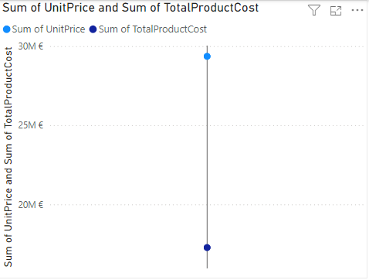
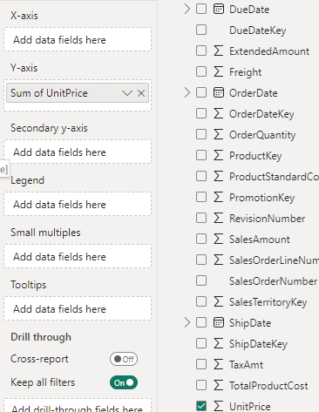
Lines and zones
Note: This exercise requires AdventureWorksDW2016 database to the resource level
Add the line visualization at the scene level, then add UnitPrice and TotalProductCost to the Y axis

Slide 3
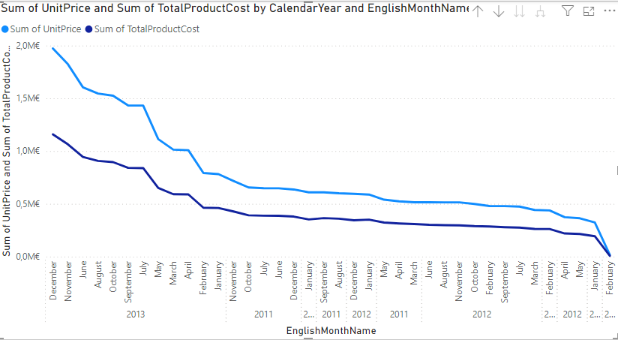
Lines and zones
And then add Calendar year and the name of the month in English to the X axis

Slide 4
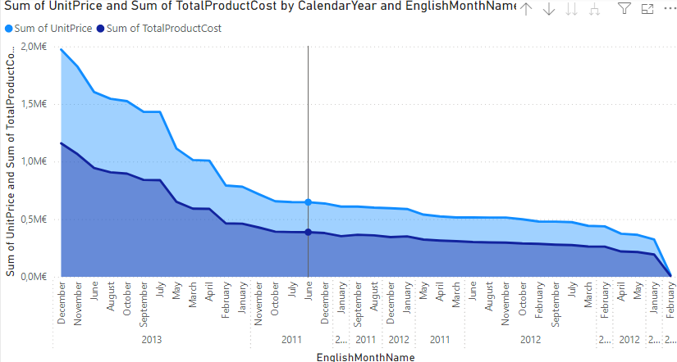
Lines and zones
Change the visualization to zone

Slide 5
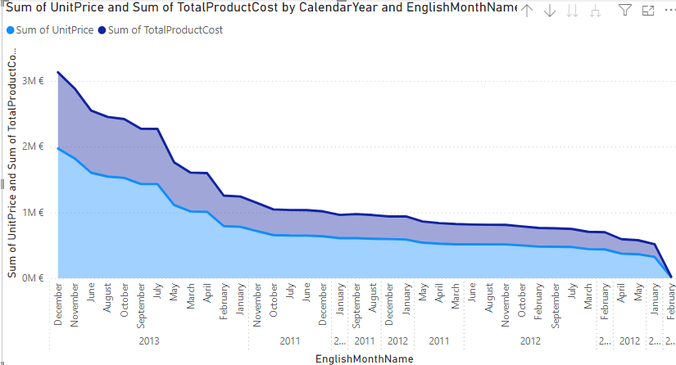
Lines and zones
Change the visualization to stacked Area

Slide 6
Lines and zones
To try to notice the difference between Surface and stacking Area

Slide 7
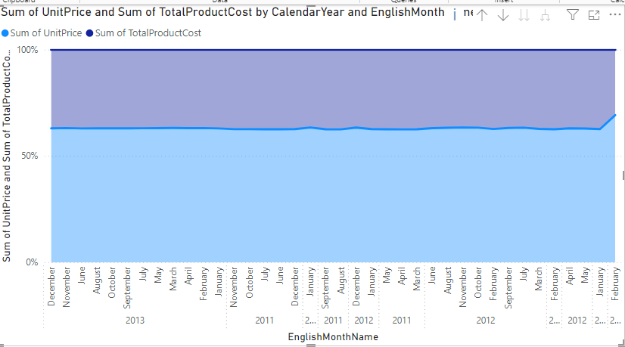
Lines and zones
Change the visualization to 100% Stacked Area

Slide 8
Thank you
Thank you

